Slide 1


Noida Institute of Engineering and Technology, Greater Noida
Design Pattern
Unit: III
Introduction to Design Pattern
PARUL GOEL
(Asst. Professor)
CSE Department
Course Details (B. Tech. 5th Sem)

Slide 2
Faculty Introduction
Name | Ibrar Ahmed
Qualification | M. Tech. (Computer Engineering)
Designation | Assistant Professor
Department | Computer Science & Engineering
Total Experience | 4 years
NIET Experience | 1 years
Subject Taught | Design & Analysis of Algorithm, Data Structures, Artificial Intelligence, Soft Computing, C Programming, Web Technology, Discrete Mathematics.

Slide 3
Unit III Content
Structural Pattern Part-I :
Adapter Pattern
Bridge Pattern
Composite Pattern
Structural Pattern Part-II :
Decorator Pattern
Facade Pattern
Flyweight Pattern
Proxy Pattern

Slide 4
Unit III Objective
In Unit III, the students will be able to find
Definitions of terms and concepts.
The idea of a pattern.
The origins of all design patterns.
How Patterns Work in software design.
Scope of development activity: applications, toolkits, frameworks.
All Structural Pattern and their need.

Slide 5
Topic Objective
Topic : Structural Pattern (Adapter)
In this topic, the students will gain , The idea of a Structural design pattern, It concerned with how classes and objects can be composed, to form larger structures. The structural design patterns simplifies the structure by identifying the relationships.

Slide 6
Structural design patterns
Structural design patterns:-
Structural design patterns are concerned with how classes and objects can be composed, to form larger structures.
The structural design patterns simplifies the structure by identifying the relationships.
These patterns focus on, how the classes inherit from each other and how they are composed from other classes.
structural design patterns are design patterns that ease the design by identifying a simple way to realize relationships among entities. Examples of Structural Patterns include Adapter pattern, Bridge, Composite etc.

Slide 7
Structural patterns (Adapter Pattern)
Adapter Pattern:-
An Adapter Pattern says that just "converts the interface of a class into another interface that a client wants".
In other words, to provide the interface according to client requirement while using the services of a class with a different interface.
The Adapter Pattern is also known as Wrapper.
Advantage of Adapter Pattern:-
It allows two or more previously incompatible objects to interact.
It allows reusability of existing functionality.

Slide 8
Structural patterns (Adapter Pattern)
Usage of Adapter pattern:-
It is used
When an object needs to utilize an existing class with an incompatible interface.
When you want to create a reusable class that cooperates with classes which don't have compatible interfaces.
When you want to create a reusable class that cooperates with classes which don't have compatible interfaces.

Slide 9
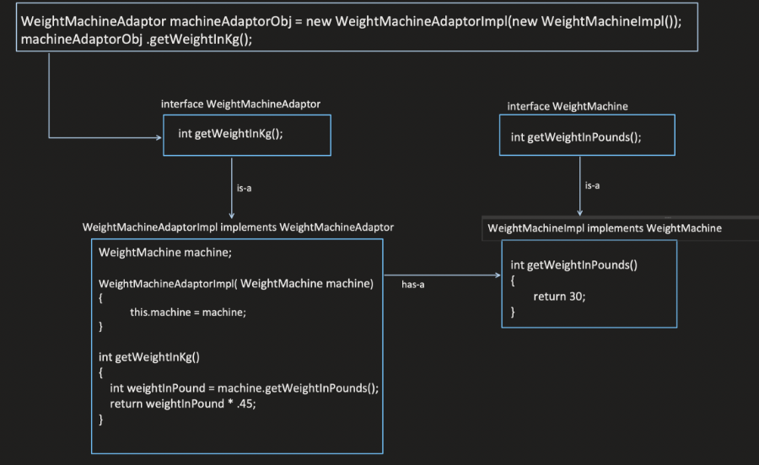

Slide 10
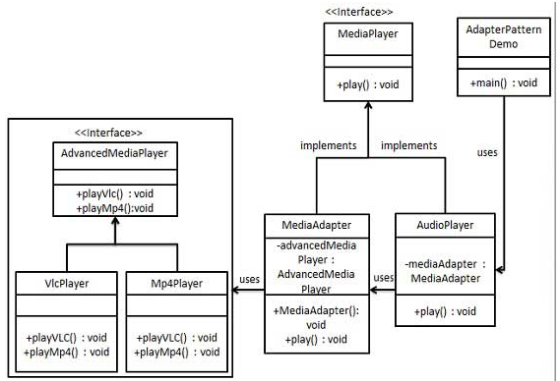
UML\Structure for Adapter Design Pattern

Slide 11
Implementation of (Adapter Design Pattern)
We have a MediaPlayer interface and a concrete class AudioPlayer implementing the MediaPlayer interface. AudioPlayer can play mp3 format audio files by default.
We are having another interface AdvancedMediaPlayer and concrete classes implementing the AdvancedMediaPlayer interface. These classes can play vlc and mp4 format files.
We want to make AudioPlayer to play other formats as well. To attain this, we have created an adapter class MediaAdapter which implements the MediaPlayer interface and uses AdvancedMediaPlayer objects to play the required format.
AudioPlayer uses the adapter class MediaAdapter passing it the desired audio type without knowing the actual class which can play the desired format. AdapterPatternDemo, our demo class will use AudioPlayer class to play various formats.

Slide 12
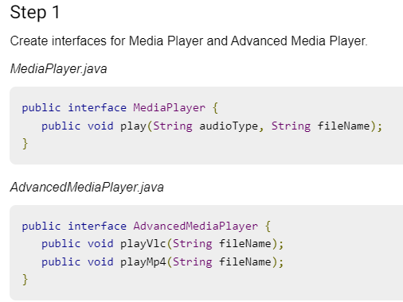
Implementation of (Adapter Design Pattern)

Slide 13
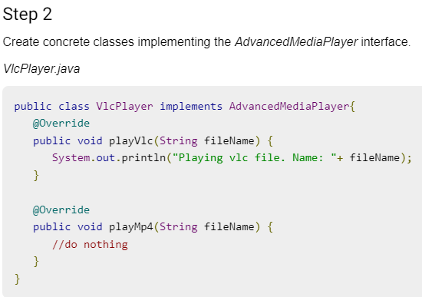
Implementation of (Adapter Design Pattern)

Slide 14
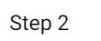
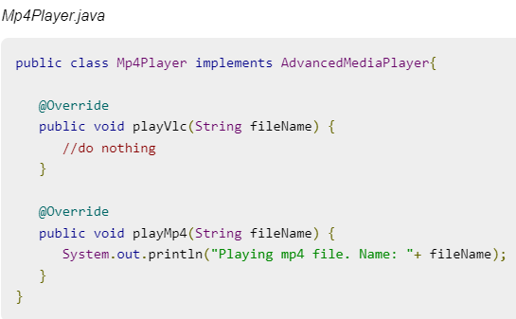
Implementation of (Adapter Design Pattern)

Slide 15
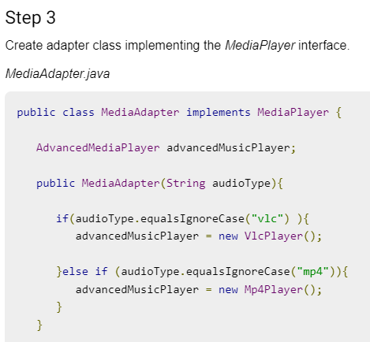
Implementation of (Adapter Design Pattern)

Slide 16
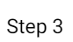
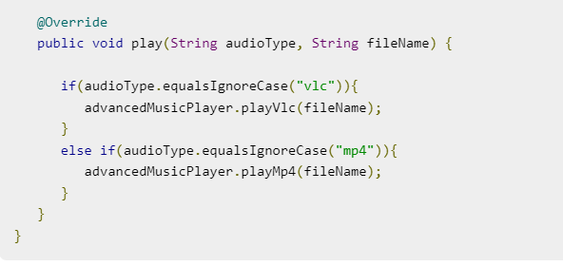
Implementation of (Adapter Design Pattern)

Slide 17
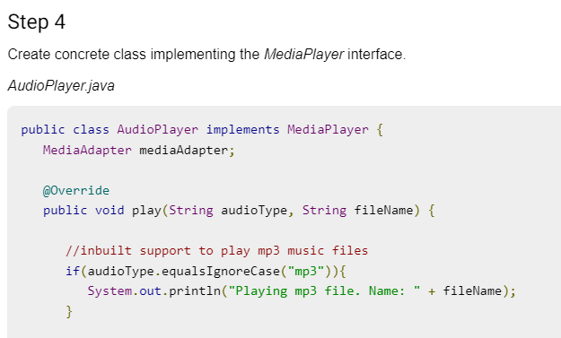
Implementation of (Adapter Design Pattern)

Slide 18
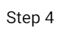
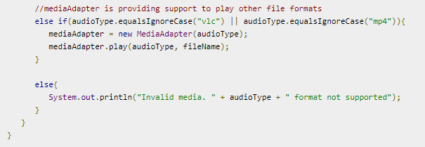
Implementation of (Adapter Design Pattern)

Slide 19
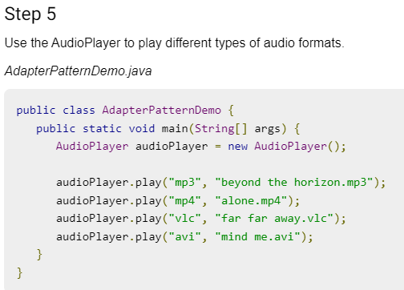
Implementation of (Adapter Design Pattern)

Slide 20
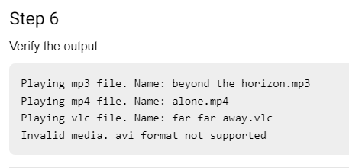
Implementation of (Adapter Design Pattern)

Slide 21
Topic Objective
Topic : Structural Pattern (Bridge Design Pattern)
In this topic, the students will gain , The idea of a Structural design pattern, It concerned with how classes and objects can be composed, to form larger structures. "decouple the functional abstraction from the implementation so that the two can vary independently".

Slide 22
Structural patterns (Bridge Pattern)
Bridge Design Pattern:-
A Bridge Pattern says that just "decouple the functional abstraction from the implementation so that the two can vary independently".
The Bridge Pattern is also known as Handle or Body. This pattern involves an interface which acts as a bridge which makes the functionality of concrete classes independent from interface implementer classes.
Bridge is used when we need to decouple an abstraction from its implementation so that the two can vary independently. This type of design pattern comes under structural pattern as this pattern decouples implementation class and abstract class by providing a bridge structure between them.

Slide 23
Structural patterns (Bridge Pattern)
Advantage of Bridge Pattern:-
It enables the separation of implementation from the interface.
It improves the extensibility.
It allows the hiding of implementation details from the client.
Usage of Bridge Pattern:-
When you don't want a permanent binding between the functional abstraction and its implementation.
When both the functional abstraction and its implementation need to extended using sub-classes.
It is mostly used in those places where changes are made in the implementation does not affect the clients.

Slide 24
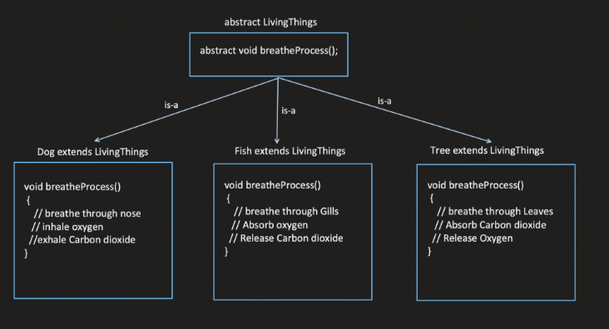

Slide 25
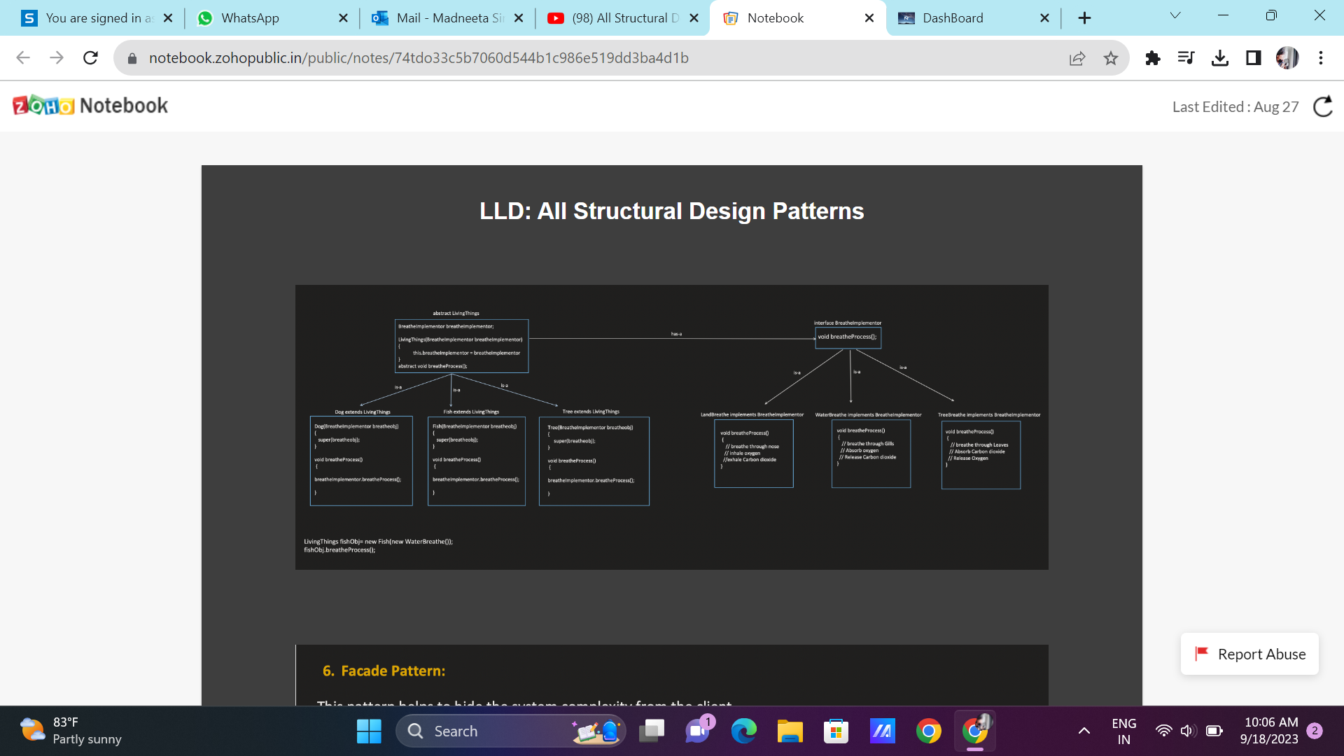

Slide 26
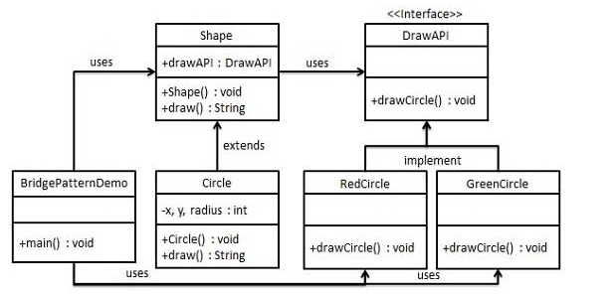
UML\Structure for Bridge Design Pattern

Slide 27
Implementation of (Bridge Design Pattern)
We are demonstrating use of Bridge pattern via following example in which a circle can be drawn in different colors using same abstract class method but different bridge implementer classes.
We have a DrawAPI interface which is acting as a bridge implementer and concrete classes RedCircle, GreenCircle implementing the DrawAPI interface. Shape is an abstract class and will use object of DrawAPI. BridgePatternDemo, our demo class will use Shape class to draw different colored circle.

Slide 28
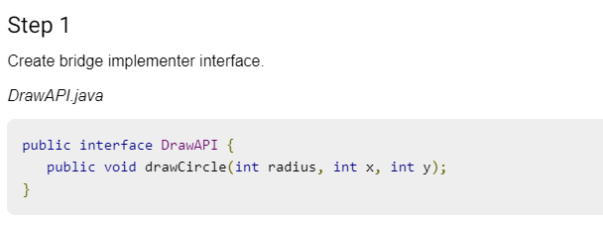
Implementation of (Bridge Design Pattern)

Slide 29
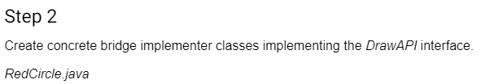
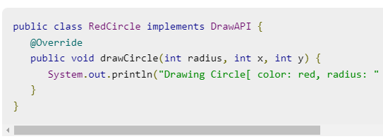
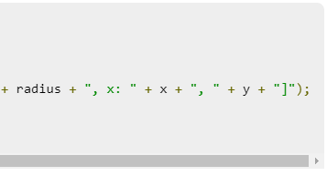
Implementation of (Bridge Design Pattern)

Slide 30
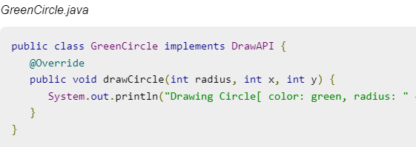
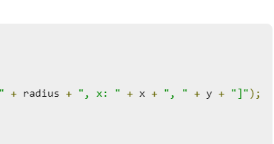
Implementation of (Bridge Design Pattern)

Slide 31
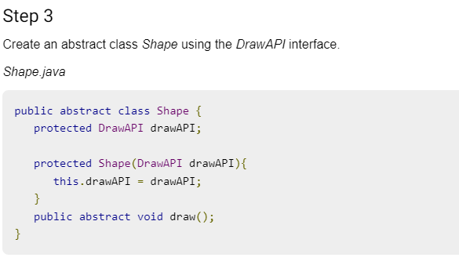
Implementation of (Bridge Design Pattern)

Slide 32
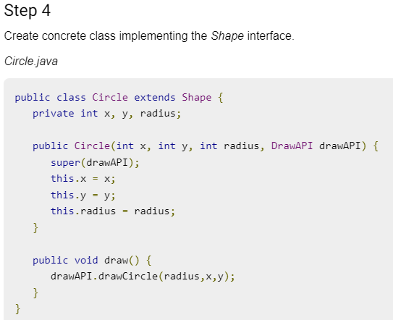
Implementation of (Bridge Design Pattern)

Slide 33
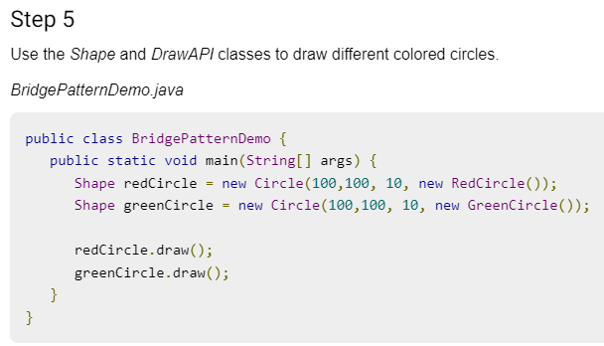
Implementation of (Bridge Design Pattern)

Slide 34
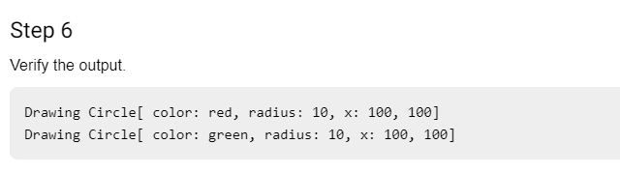
Implementation of (Bridge Design Pattern)

Slide 35
Topic Objective
Topic : Structural Pattern (Composite Design Pattern)
In this topic, the students will gain , The idea of a Structural design pattern, A Composite Pattern says that just "allow clients to operate in generic manner on objects that may or may not represent a hierarchy of objects".

Slide 36
Structural patterns (Composite Pattern)
Composite Design Pattern:-
A Composite Pattern says that just "allow clients to operate in generic manner on objects that may or may not represent a hierarchy of objects".
Composite pattern is used where we need to treat a group of objects in similar way as a single object. Composite pattern composes objects in term of a tree structure to represent part as well as whole hierarchy. This type of design pattern comes under structural pattern as this pattern creates a tree structure of group of objects.
This pattern creates a class that contains group of its own objects. This class provides ways to modify its group of same objects.

Slide 37
Structural patterns (Composite Design Pattern)
Advantage of Composite Design Pattern:-
It defines class hierarchies that contain primitive and complex objects.
It makes easier to you to add new kinds of components.
It provides flexibility of structure with manageable class or interface.
Usage of Composite Design Pattern:-
It is used:
When you want to represent a full or partial hierarchy of objects.
When the responsibilities are needed to be added dynamically to the individual objects without affecting other objects. Where the responsibility of object may vary from time to time.

Slide 38
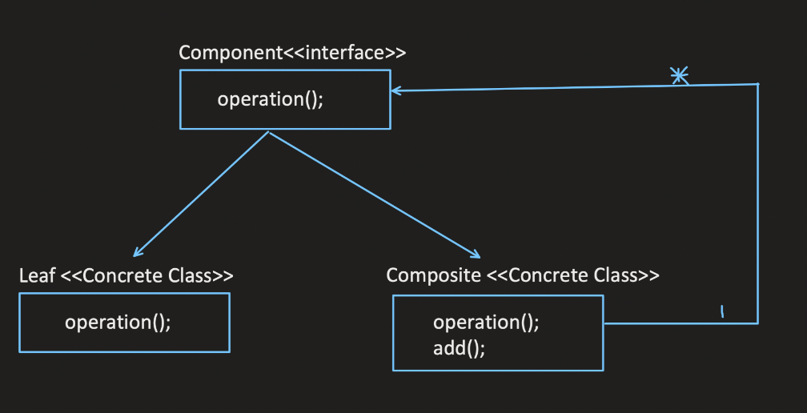

Slide 39
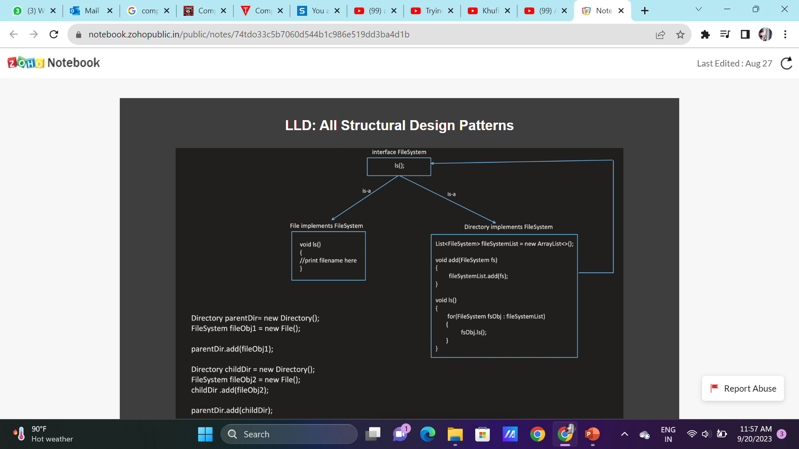

Slide 40
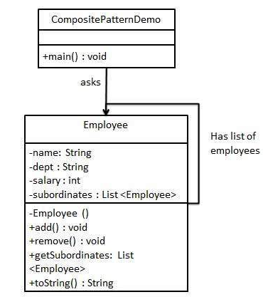
UML\Structure for Composite Design Pattern

Slide 41
Implementation of (Composite Design Pattern)
This pattern creates a class that contains group of its own objects. This class provides ways to modify its group of same objects.
We are demonstrating use of composite pattern via following example in which we will show employees hierarchy of an organization.
We have a class Employee which acts as composite pattern actor class. CompositePatternDemo, our demo class will use Employee class to add department level hierarchy and print all employees.

Slide 42

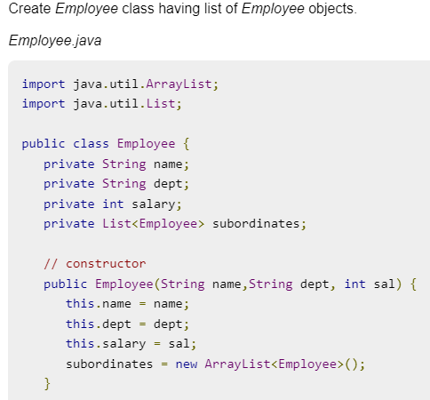

Implementation of (Composite Design Pattern)

Slide 43
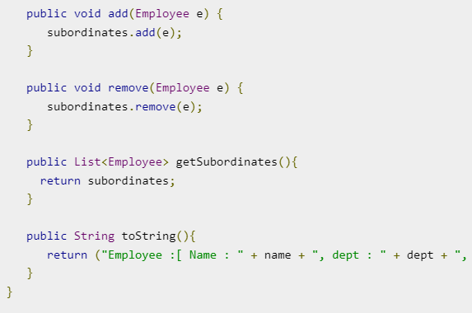
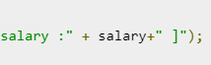
Implementation of (Composite Design Pattern)

Slide 44
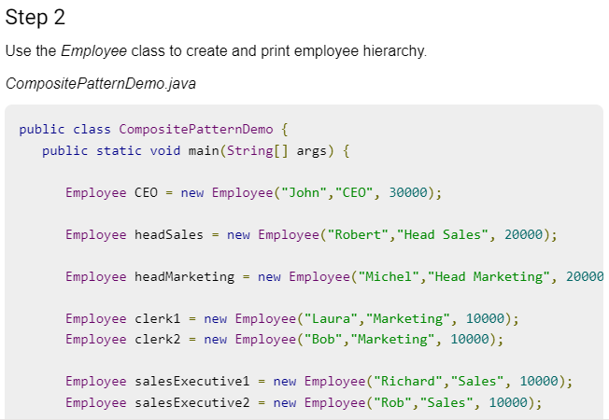
Implementation of (Composite Design Pattern)

Slide 45
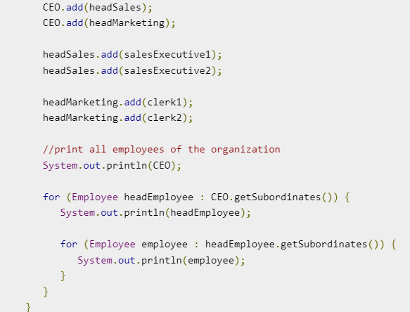
Implementation of (Composite Design Pattern)

Slide 46
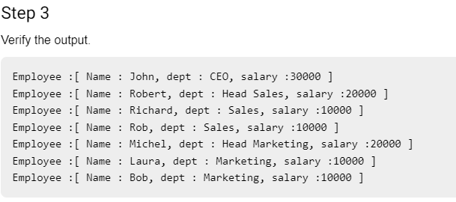
Implementation of (Composite Design Pattern)

Slide 47
Topic Objective
Topic : Structural Pattern II (Decorator Pattern)
In this topic, the students will gain , The idea of a Structural design pattern, A Decorator Pattern says that just "attach a flexible additional responsibilities to an object dynamically".

Slide 48
Structural patterns II (Decorator Pattern)
Decorator Design Pattern:-
A Decorator Pattern says that just "attach a flexible additional responsibilities to an object dynamically".
In other words, The Decorator Pattern uses composition instead of inheritance to extend the functionality of an object at runtime. The Decorator Pattern is also known as Wrapper.
Decorator pattern allows a user to add new functionality to an existing object without altering its structure.
This pattern creates a decorator class which wraps the original class and provides additional functionality keeping class methods signature intact.

Slide 49
Structural patterns (Decorator Design Pattern)
Advantage of Decorator Design Pattern:-
It provides greater flexibility than static inheritance.
It enhances the extensibility of the object, because changes are made by coding new classes. It simplifies the coding by allowing you to develop a series of functionality from targeted classes instead of coding all of the behavior into the object.
Usage of Decorator Design Pattern:-
It is used:
When you want to transparently and dynamically add responsibilities to objects without affecting other objects.
When you want to add responsibilities to an object that you may want to change in future. Extending functionality by sub-classing is no longer practical.

Slide 50
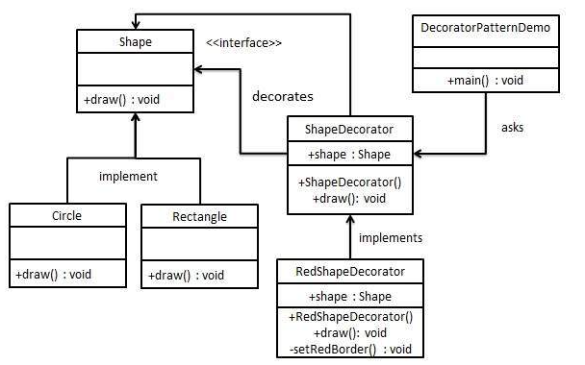
UML\Structure for Decorator Design Pattern

Slide 51
Implementation of (Decorator Design Pattern)
We are demonstrating the use of decorator pattern via following example in which we will decorate a shape with some color without alter shape class.
We're going to create a Shape interface and concrete classes implementing the Shape interface. We will then create an abstract decorator class ShapeDecorator implementing the Shape interface and having Shape object as its instance variable.
RedShapeDecorator is concrete class implementing ShapeDecorator.
DecoratorPatternDemo, our demo class will use RedShapeDecorator to decorate Shape objects.

Slide 52
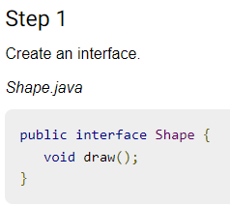
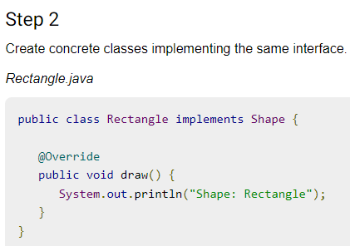
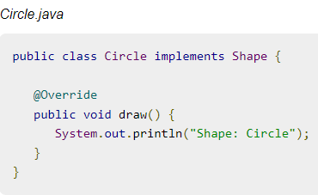
Implementation of (Decorator Design Pattern)

Slide 53
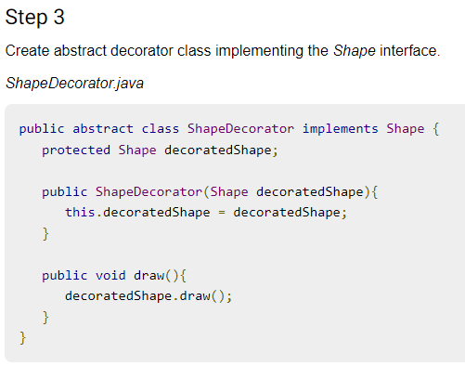
Implementation of (Decorator Design Pattern)

Slide 54

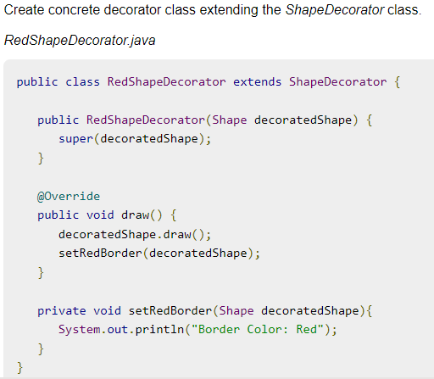
Implementation of (Decorator Design Pattern)

Slide 55
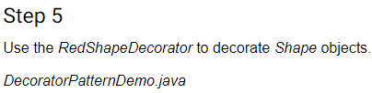
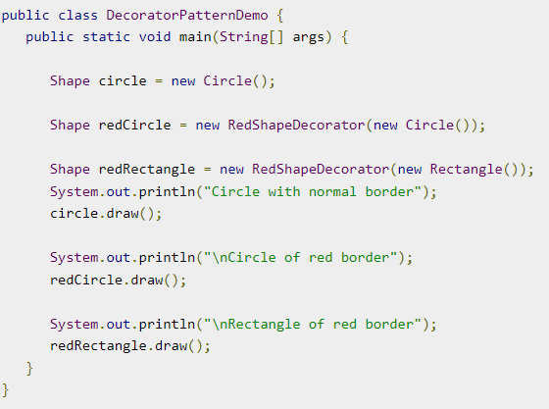
Implementation of (Decorator Design Pattern)

Slide 56
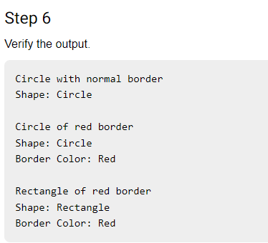
Implementation of (Decorator Design Pattern)

Slide 57
Topic Objective
Topic : Structural Pattern II (Facade Pattern)
In this topic, the students will gain , The idea of a Structural design pattern, A Facade Pattern says that just "just provide a unified and simplified interface to a set of interfaces in a subsystem, therefore it hides the complexities of the subsystem from the client".

Slide 58
Structural patterns II (Facade Pattern)
Facade Design Pattern:-
A Facade Pattern says that just "just provide a unified and simplified interface to a set of interfaces in a subsystem, therefore it hides the complexities of the subsystem from the client".
In other words, Facade Pattern describes a higher-level interface that makes the sub-system easier to use.
Practically, every Abstract Factory is a type of Facade.
Facade pattern hides the complexities of the system and provides an interface to the client using which the client can access the system.

Slide 59
Structural patterns (Facade Design Pattern)
Advantage of Facade Design Pattern:-
It shields the clients from the complexities of the sub-system components.
It promotes loose coupling between subsystems and its clients.
Usage of Facade Design Pattern:-
It is used:
When you want to provide simple interface to a complex sub-system.
When several dependencies exist between clients and the implementation classes of an abstraction.

Slide 60
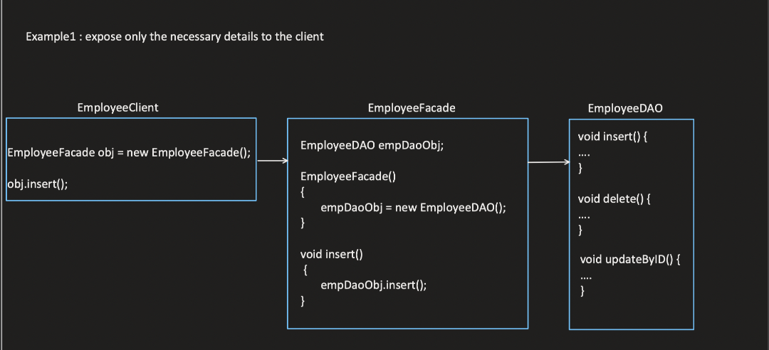

Slide 61
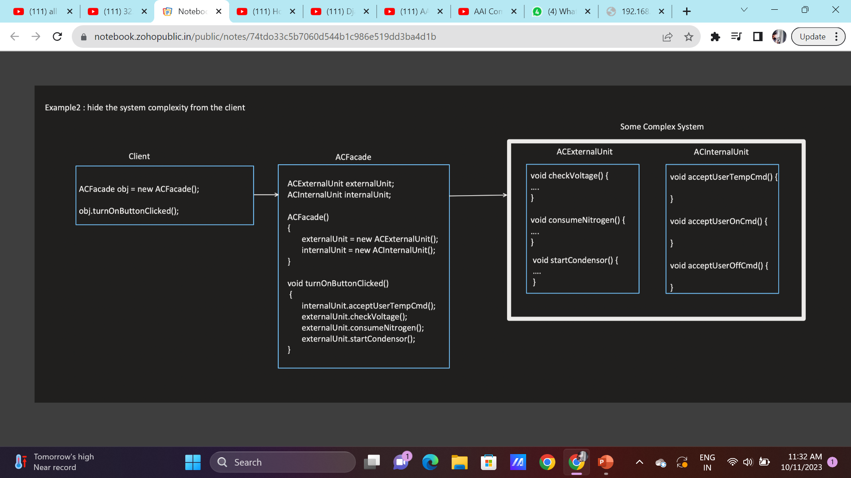

Slide 62
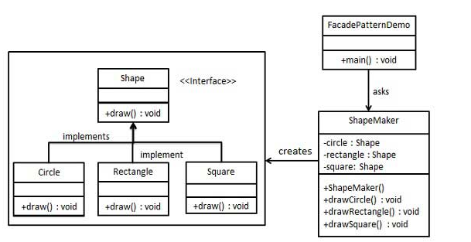
UML\Structure for Facade Design Pattern

Slide 63
Implementation of (Facade Design Pattern)
We are going to create a Shape interface and concrete classes implementing the Shape interface. A facade class ShapeMaker is defined as a next step.
ShapeMaker class uses the concrete classes to delegate user calls to these classes. FacadePatternDemo, our demo class, will use ShapeMaker class to show the results.
This pattern involves a single class which provides simplified methods required by client and delegates calls to methods of existing system classes.

Slide 64
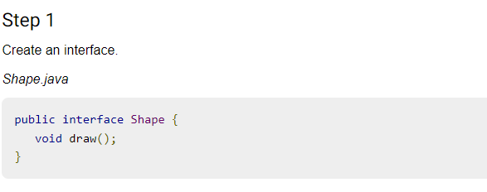
Implementation of (Facade Design Pattern)

Slide 65
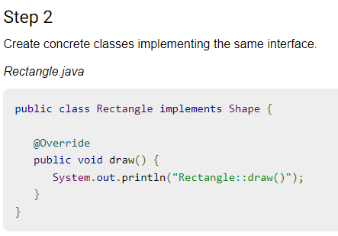


Implementation of (Facade Design Pattern)

Slide 66


Implementation of (Facade Design Pattern)

Slide 67


Implementation of (Facade Design Pattern)

Slide 68
Topic Objective
Topic : Structural Pattern II (Flyweight Pattern)
In this topic, the students will gain , The idea of a Structural design pattern, A Flyweight Pattern says that just "to reuse already existing similar kind of objects by storing them and create new object when no matching object is found".

Slide 69
Structural patterns II (Flyweight Pattern)
Flyweight Design Pattern:-
A Flyweight Pattern says that just "to reuse already existing similar kind of objects by storing them and create new object when no matching object is found".
Flyweight pattern is primarily used to reduce the number of objects created and to decrease memory footprint and increase performance. This type of design pattern comes under structural pattern as this pattern provides ways to decrease object count thus improving the object structure of application.
Only 5 colors are available so color property is used to check already existing Circle objects.

Slide 70
Structural patterns (Flyweight Design Pattern)
Advantage of Flyweight Design Pattern:-
It reduces the number of objects.
It reduces the amount of memory and storage devices required if the objects are persisted
Usage of Flyweight Design Pattern:-
It is used:
When an application uses number of objects
When the storage cost is high because of the quantity of objects.
When the application does not depend on object identity.

Slide 71

UML\Structure for Flyweight Design Pattern

Slide 72
Implementation of (Flyweight Design Pattern)
We are going to create a Shape interface and concrete class Circle implementing the Shape interface. A factory class ShapeFactory is defined as a next step.
ShapeFactory has a HashMap of Circle having key as color of the Circle object. Whenever a request comes to create a circle of particular color to ShapeFactory, it checks the circle object in its HashMap, if object of Circle found, that object is returned otherwise a new object is created, stored in hashmap for future use, and returned to client.
FlyWeightPatternDemo, our demo class, will use ShapeFactory to get a Shape object. It will pass information (red / green / blue/ black / white) to ShapeFactory to get the circle of desired color it needs.

Slide 73


Implementation of (Flyweight Design Pattern)

Slide 74


Implementation of (Flyweight Design Pattern)
Step 2 cont…….

Slide 75


Implementation of (Flyweight Design Pattern)

Slide 76


Implementation of (Flyweight Design Pattern)

Slide 77

Implementation of (Flyweight Design Pattern)

Slide 78
Topic Objective
Topic : Structural Pattern II (Proxy Pattern)
In this topic, the students will gain , The idea of a Structural design pattern, According to GoF, a Proxy Pattern "provides the control for accessing the original object".

Slide 79
Structural patterns II (Proxy Pattern)
Proxy Design Pattern:-
Simply, proxy means an object representing another object.According to GoF, a Proxy Pattern "provides the control for accessing the original object".
So, we can perform many operations like hiding the information of original object, on demand loading etc.Proxy pattern is also known as Surrogate or Placeholder.
In proxy pattern, a class represents functionality of another class. This type of design pattern comes under structural pattern.
In proxy pattern, we create object having original object to interface its functionality to outer world.

Slide 80
Structural patterns (Proxy Design Pattern)
Advantage of Proxy Design Pattern:-
It provides the protection to the original object from the outside world.
Usage of Proxy Design Pattern:-
It is used:
It can be used in Virtual Proxy scenario---Consider a situation where there is multiple database call to extract huge size image.
It can be used in Protective Proxy scenario---It acts as an authorization layer to verify that whether the actual user has access the appropriate content or not.

Slide 81

UML\Structure for Proxy Design Pattern

Slide 82
Implementation of (Proxy Design Pattern)
We are going to create an Image interface and concrete classes implementing the Image interface. ProxyImage is a a proxy class to reduce memory footprint of RealImage object loading.
ProxyPatternDemo, our demo class, will use ProxyImage to get an Image object to load and display as it needs.
In proxy pattern, a class represents functionality of another class. This type of design pattern comes under structural pattern.

Slide 83



Implementation of (Proxy Design Pattern)

Slide 84

Implementation of (Proxy Design Pattern)
Step -2 Cont.……..

Slide 85


Implementation of (Proxy Design Pattern)

Slide 86
Daily Quiz
You want to minimize development cost by reusing methods? Which design pattern would you choose?
Adapter Pattern
Singleton Pattern
Delegation pattern
Immutable Pattern
Which design pattern defines one-to-many dependency among objects?
Singleton pattern
Facade Pattern
Observer pattern
Factory method pattern

Slide 87
Daily Quiz
Which design pattern suggest multiple classes through which request is passed and multiple but only relevant classes carry out operations on the request.
Singleton pattern
Chain of responsibility pattern
State pattern
Bridge pattern
Most user interface design patterns fall with in one of ____ categories of patterns.
5
10
25
100

Slide 88
Weekly Assignment
What are Design Patterns in Java? What are the types of design patterns in Java.
What are the Structural Patterns and What Is Façade Pattern.
What Is Flyweight Design Pattern.
Explain Facade Pattern in Java.
5. Explain the Proxy pattern.

Slide 89
Topic Link ( YouTube & NPTEL Video Links)
YouTube /other Video Links
https://youtu.be/rI4kdGLaUiQ?list=PL6n9fhu94yhUbctIoxoVTrklN3LMwTCmd
https://youtu.be/v9ejT8FO-7I?list=PLrhzvIcii6GNjpARdnO4ueTUAVR9eMBpc
https://youtu.be/VGLjQuEQgkI?list=PLt4nG7RVVk1h9lxOYSOGI9pcP3I5oblbx

Slide 90
MCQ (End of Unit)
1. Design patterns can be classified in _______ categories.
1
2
3
4
2. Which design patterns are specifically concerned with communication between objects?
Creational Patterns
Structural Patterns
Behavioral Patterns
J2EE Patterns

Slide 91
MCQ (End of Unit)
3. Which design pattern provides a single class which provides simplified methods required by client and delegates call to those methods?
Adapter pattern
Builder pattern
Facade pattern
Prototype pattern
4. Which design pattern suggests multiple classes through which request is passed and multiple but only relevant classes carry out operations on the request?
Singleton pattern
Chain of responsibility pattern
State pattern
Bridge pattern

Slide 92
Glossary Questions
Top 10 design pattern interview questions
What are design patterns?
How are design patterns categorized?
Explain the benefits of design patterns in Java.
Describe the factory pattern.
Differentiate ordinary and abstract factory design patterns.
What do you think are the advantages of builder design patterns?
How is the bridge pattern different from the adapter pattern?
What is a command pattern?
Describe the singleton pattern along with its advantages and disadvantages.
What are anti patterns?

Slide 93
Expected Questions for University Exam
What are design patterns?
How are design patterns categorized?
Explain the benefits of design patterns in Java.
Describe the factory pattern.
Differentiate ordinary and abstract factory design patterns.
What do you think are the advantages of builder design patterns?
How is the bridge pattern different from the adapter pattern?
What is a command pattern?
Describe the singleton pattern along with its advantages and disadvantages.
What are anti patterns?

Slide 94
Recap of Unit
Till Now we understand, The idea of a Structural design pattern, It concerned with how classes and objects can be composed, to form larger structures. The structural design patterns simplifies the structure by identifying the relationships.
A Facade Pattern says that just "just provide a unified and simplified interface to a set of interfaces in a subsystem, therefore it hides the complexities of the subsystem from the client".
You also learn, a Proxy Pattern "provides the control for accessing the original object".
A Flyweight Pattern says that just "to reuse already existing similar kind of objects by storing them and create new object when no matching object is found".

